Slide 1
Image Forensics
Group Members:
Syed Bahadur Ali Shah
M.Armughan
Sahil Raja

Slide 2
Introduction
Reference: Digital Corpora org
Company M57BIZ Information of Employees were Leaked
Excel File : m57plan.xlsx

Slide 3
Employees
Alison: Company Owner
Jean: CFO
Programmers: Bob, Carole, David, Emmy
Marketing: Gina, Harris
BizDev: Indy

Slide 4
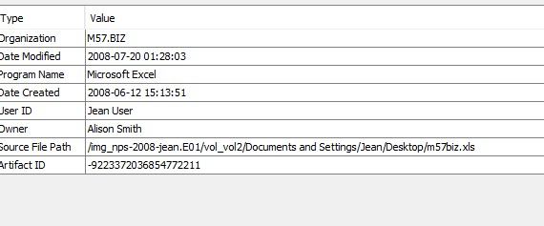
Objectives
When was the excel file created?
How did it reach the competitors site?
Who was involved from the company?

Slide 5
COLLECTION STAGE

Slide 6
Interviews
Alison (President):
• I don't know what Jean is talking about.
• I never asked Jean for the spreadsheet.
I never received the spreadsheet by email.
Jean (CFO):
• Alison asked me to prepare the spreadsheet as part of new funding round.
• Alison asked me to send the spreadsheet to her by email.
• That's all I know

Slide 7
Data Provided
Excel Sheet provided
Image of Jean’s Laptop
Company details

Slide 8
Tools Used for Analysis
Autopsy (Windows)
AccessData FTK Imager
Stegspy
Stellar Email Forensics

Slide 9
Important data Obtained
File creation date
Email containing Excel File
Deleted Emails

Slide 10
Analysis

Slide 11
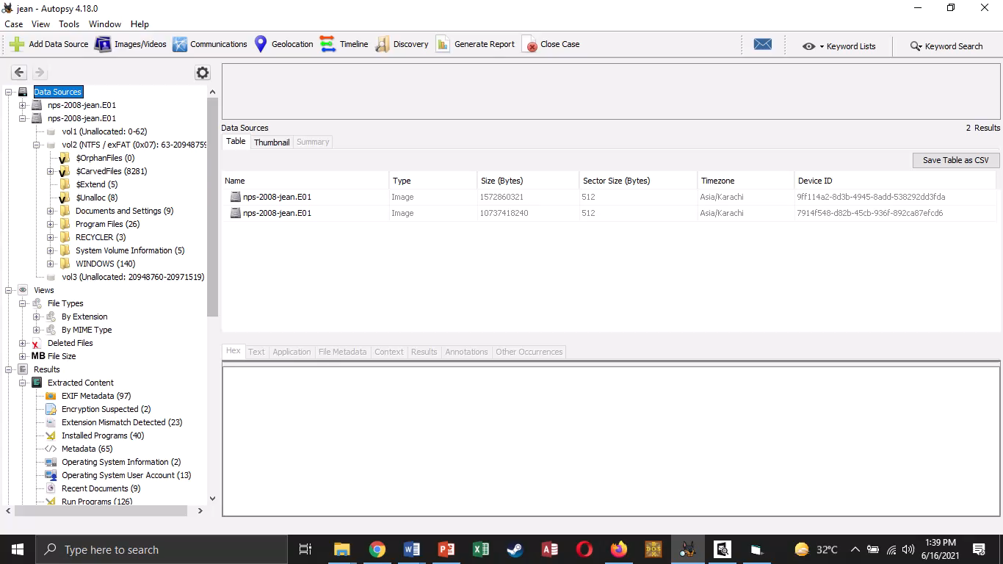

Slide 12
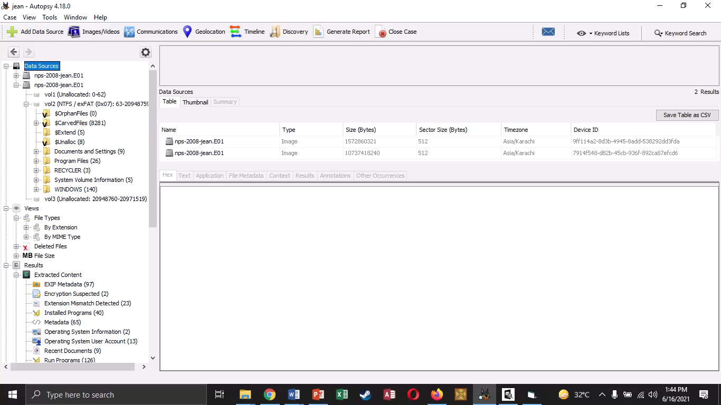

Slide 13
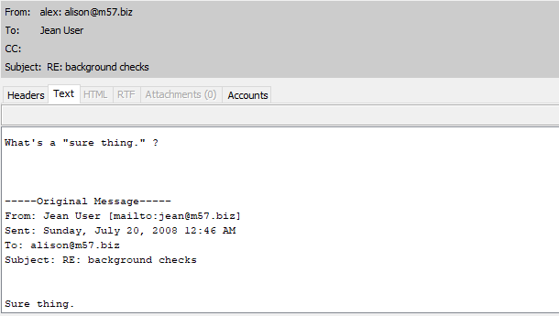
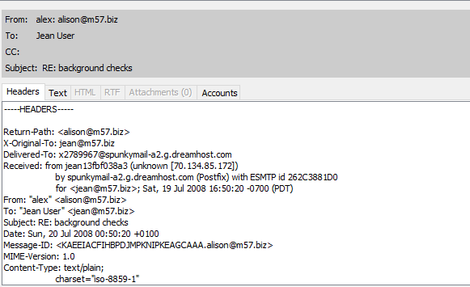

Slide 14
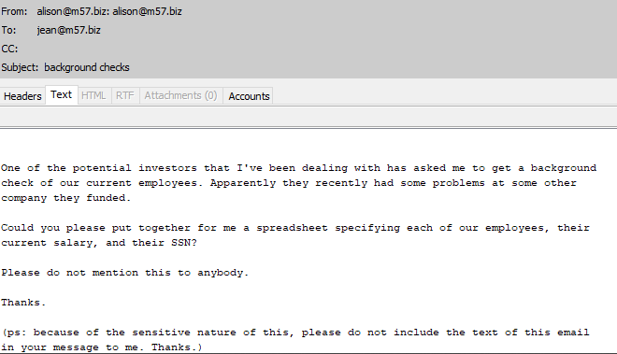
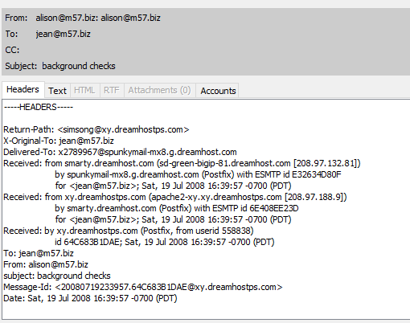

Slide 15
